Slide 1
Bài 9
Tính đa hình
(Polymorphysm)

Slide 2
Contents
Polymorphism?
Static polymorphism (or Compile-time polymorphism in Java)
Dynamic Polymorphism (or Run-time polymorphism in Java)
Examples

Slide 3
Polymorphism
One of the important concepts in Object Oriented Programming (OOP) is polymorphism which means that a single action can be performed in different ways.
It is derived from the Greek words: poly and morphs meaning many and forms. The different forms exist when they are related through inheritance.

Slide 4
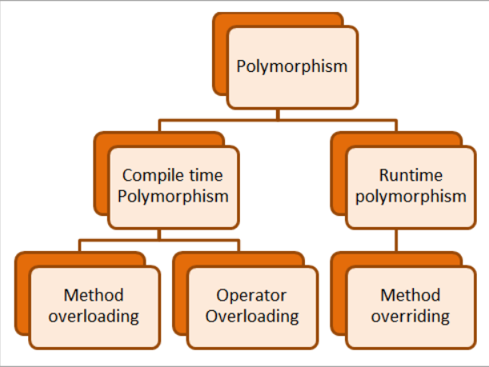
Polymorphism in Java
Java supports two types of Polymorphism:
1- Compile-time polymorphism
(đa hình tĩnh)
2- Run-time polymorphism
(đa hình động)

Slide 5
Static polymorphism
Static polymorphism is also known as “Compile-time polymorphism”. Whatever polymorphism is to be performed, is performed at compile time.
In Java, the compile-time polymorphism is performed using “Method Overloading”. Using method overloading, we can have one or more methods with the same name and only differentiated on numbers or type or order of parameters.
Method overloading is the most common implementation of compile-time polymorphism in Java. Java also supports operator overloading.

Slide 6
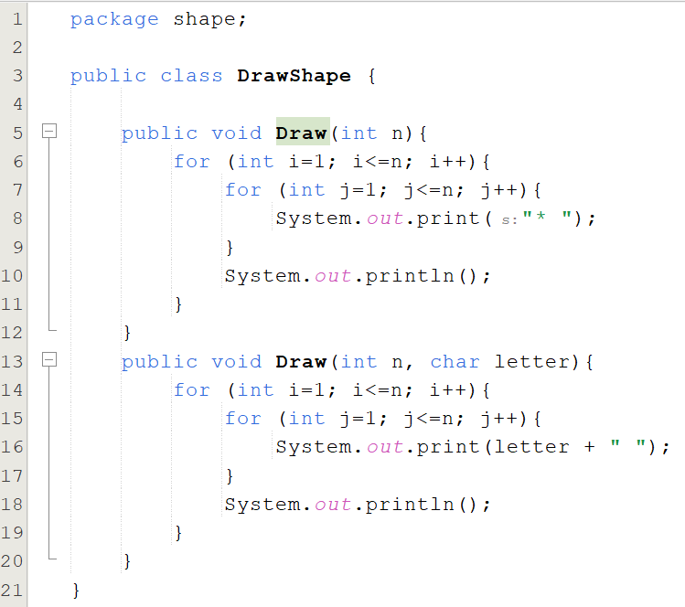
Polymorphism Example using Overloading method
Using Overloading Method

Slide 7
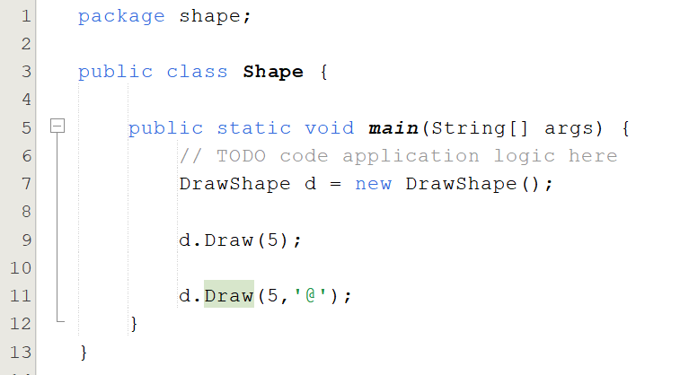


Polymorphism Example using Overloading method
Overloading method in Java
#1) Type Of Parameters
#2) Number Of Parameters
#3) Sequence Of Parameters

Slide 8
Dynamic polymorphism
Dynamic polymorphism is also known as “Run-time polymorphism”.
In this form of polymorphism in java, the compiler doesn’t determine the method to be executed. It’s the Java Virtual Machine (JVM) that performs the process at the run time.
Dynamic polymorphism in Java refers to the process when a call to an overridden process is resolved at the run time.
The reference variable of a superclass calls the overridden method. As the name dynamic connotes, dynamic polymorphism happens among different classes as opposed to static polymorphism.
Dynamic polymorphism facilitates the overriding of methods in Java which is core for run-time polymorphism.

Slide 9
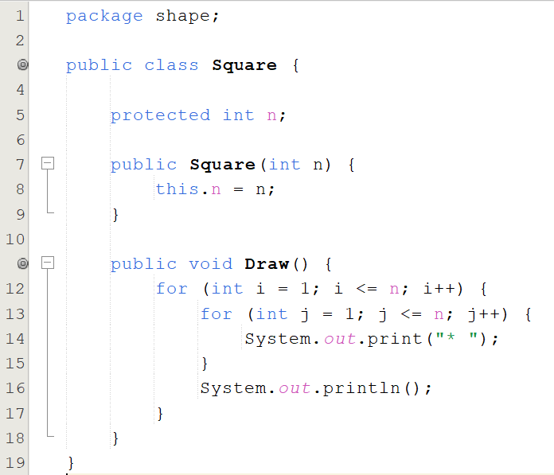
Polymorphism Example using Method Overriding
Superclass

Slide 10
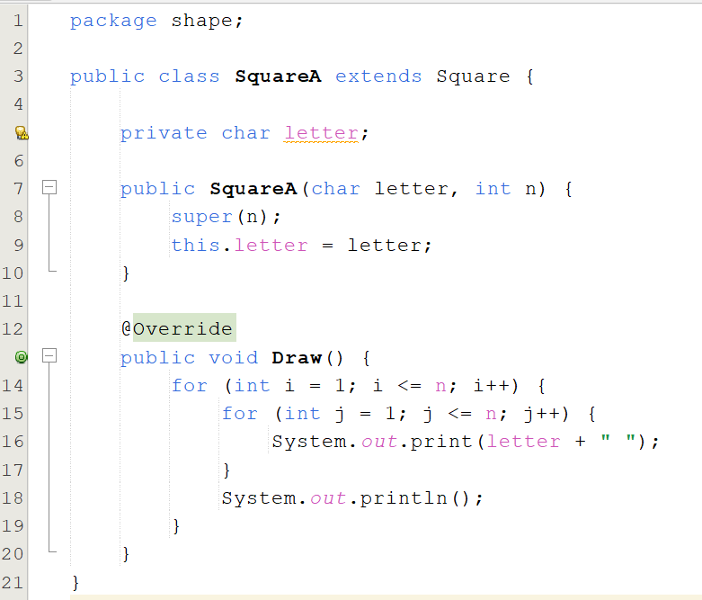
Polymorphism Example using Method Overriding
Subclass
Method Overriding

Slide 11
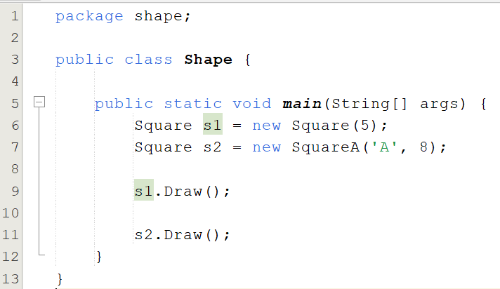

Polymorphism Example using Method Overriding

Slide 12

Q&A

